Slide 1
Book Recommendation System
UE20CS302 – Machine Intelligence
Mini Project
Project Title : Book Recommendation System
Project Guide : Dr. Arti Arya
Name: Rushil Ranjan SRN: PES2UG20CS288

Slide 2
Problem Statement
In the present day scenario, the amount of information on the internet grows rapidly and people need some instruments to find and access appropriate information. One such instrument is a Recommendation System. Recommendation systems help to navigate and receive necessary information quickly.
This project provides a quick and intuitive book recommendation system that helps readers to find the right books to read.
We have used a Popularity-Based Model using Weighted Rating and a Collaborative Filtering Model on the dataset extracted from Kaggle to recommend books to a user.
Notes:
Provide a basic introduction of the project and also an overview of scope it entails.
Set the context.

Slide 3
Application and Uses
The books recommendation system is used by online websites which provide ebooks like google play books, Good Read's etc ;
Book recommendation Systems serve as the best advice for a potential buyer.
Helps Online Stores like Amazon and flipkart to retain customers (readers) on their platform by giving them personalized recommendations and improve their cart value.
Notes:
Provide a basic introduction of the project and also an overview of scope it entails.
Set the context.

Slide 4
High level Architecture
DATA ACQUISITION AND PREPARATION
DATA COLLECTION
DATA CLEANING AND PRE-PROCESSING
MODEL DEVELOPMENT
MODEL EXPLORATION
MODEL TRAINING
MODEL FINE-TUNING
Popularity Based
Model Based
Collaborative Filtering
Memory Based
Notes:
Provide a basic introduction of the project and also an overview of scope it entails.
Set the context.

Slide 5
Data Summary
The dataset is consists of three csv files - Users, Books and Ratings
USERS DATASET
User-ID – Unique for each user. SHAPE OF THE DATASET - (278858, 3)
Location (contains city, state and country separated by commas)
Age
BOOKS DATASET
ISBN (unique for each book) Image-URL-S SHAPE OF THE DATASET - (271360, 8)
Book-Title Image-URL-M
Book-Author Image-URL-L
Year-Of-Publication
Publisher
RATINGS DATASET
User-ID SHAPE OF THE DATASET - (1149780, 3)
ISBN
Book-Rating

Slide 6
Literature Survey
Title of the paper | Year of Publication | Journal/Conference Name | Advantages | Limitations
Recommendation systems: Principles and Methods. | November ,2015 | Science Direct Informatics Journal , Volume 16, Issue 3 | Explains the different types of recommender systems and the methods to implement them. | Does not clearly explain the methods of evaluation.
Collaborative Filtering Recommender Systems | October, 2011 | GroupLens Human – Computer Interaction Journal, Volume 4, Issue 2 | Provides an accurate recommendation using SVD in the model-based approach and kNN for the memory based approach. | Cannot handle the cold- start problem for new users.
Popularity Based Recommender Systems using IMDB’s weighted rating algorithm. | May, 2021 | Science Direct - presented at 7th International Conference on Intelligent systems. | The weighted rating formula provides better recommendations than a basic average rating approach. | The formula skews in favor of fans or haters of a particular movie or actor.
Notes:
Provide summary of Phase – 1.
Include the suggestions and improvements made.

Slide 7
Literature Survey
Title of the paper | Year of Publication | Journal/Conference Name | Advantages | Limitations
Collaborative Filtering Based on Gaussian Mixture Model and Jaccard Similarity | 2018 | IEEE Access | Solves the impact of data sparsity. | In GMM there are lot parameters to fit, and requires lots of data and many iterations to get good results.
Research on Book Recommendation Algorithm Based on Collaborative Filtering and Interest Degree | 2021 | International Conference on Document Analysis and Recognition | Using MAE and RMSE as the measurement indicators, it is concluded that the method has good convergence result. | Cold Start Problem and it doesn’t consider users who do not return the books.
Recommendation system using association rule mining. | April, 2019 | IJCSMC, Volume 8, Issue 4 | Useful for analyzing and predicting user behavior. | Can be used effectively for non-numeric data .
Notes:
Provide summary of Phase – 1.
Include the suggestions and improvements made.

Slide 8
Literature Survey
Title of the paper | Year of Publication | Journal/Conference Name | Advantages | Limitations
A Hybrid Approach using Collaborative filtering and Content based Filtering | 2018 | Iopscience- Journal of Physics : Conference Series. | Provides relevant and accurate recommendations using Pearson’s Correlation. | Requires a lot of computation. Data sparsity is another drawback .
The Pure Cold-Start Problem: A deep study about how to conquer first-time users in recommendations domains | February, 2021 | Science Direct – Elsevier, Information systems journal. | Solves the cold start problem using a method called max coverage- category exploration. | Paper proposes many non-personalized RSs which increases the complexity.
A Review on Evaluation Metrics | March 2015 | International Journal of Data Mining & Knowledge Management Process | Explains the type of evaluation metrics and the procedure to pick the best metric. | Does not explain which metric to apply when the dataset consists of outliers.
Notes:
Provide summary of Phase – 1.
Include the suggestions and improvements made.

Slide 9
Proposed Approach
Data Cleaning : We start off with cleaning the 3 datasets and removing the image URLs and dropping duplicate values. Based on the understanding from the EDA, we split the ratings dataset into explicit and implicit datasets. For this project, we use the explicit ratings to recommend books to users.
Popularity-Based Model – We use the weighted average rating formula devised by IMDB. As the name suggests Popularity based recommendation system works with the trend. It basically uses the items which are trending right now. For example, if any book is usually bought by every new user then there are chances that it may suggest that book to the user who just signed up.
Weighted Rating (WR) = (v/(v+m) * R) + (m/(m+v) * C)
Model Based Collaborative Filtering - Model based approach involves implementing machine learning algorithms to predict user's ratings. They involve dimensionality reduction methods that reduce high dimensional matrix to a much smaller matrix in lower-dimensional space. The goal of this section is to compare SVD and NMF algorithms, try different configurations of parameters and explore obtained results.
We make use of the SURPRISE library to implement SVD and NMF algorithms.
Memory-Based Collaborative Filtering
1. Item-Item Collaborative Filtering – kNN and cosine similarity is used to retrieve the top 5 similar books for a given input by the user.
2. User-Item Collaborative Filtering - We first filter out those users who have rated at least 5 books. From these filtered out users, we get over 100000 interactions. We use smoothing on these interactions. Further, we use SVD on a matrix and after the factorization. We can now recommend books to users based on their User –ID.

Slide 10
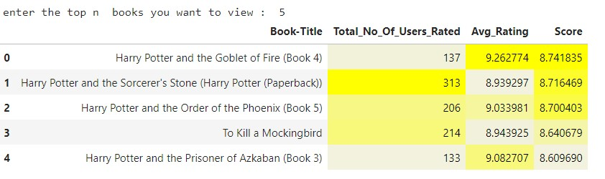
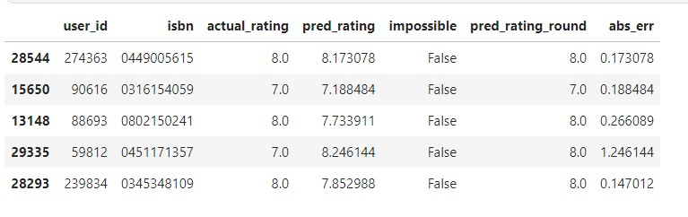
Results and Discussion
POPULARITY BASED RECOMMENDER – output screenshots
MODEL BASED RECOMMENDER
Notes:
Provide summary of Phase – 1.
Include the suggestions and improvements made.

Slide 11
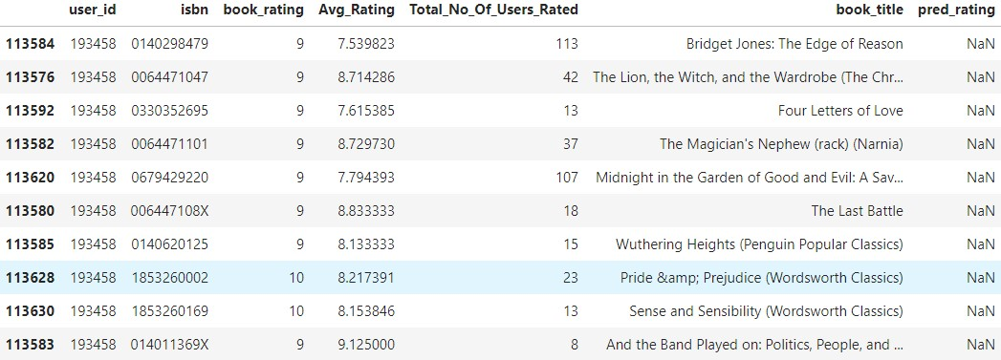
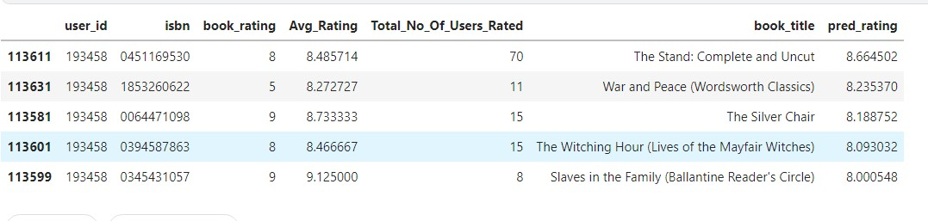
Results and Discussion
Training set ratings
Testing Set predictions
Notes:
Provide summary of Phase – 1.
Include the suggestions and improvements made.

Slide 12
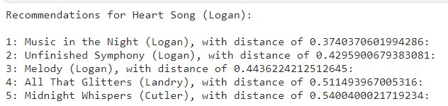
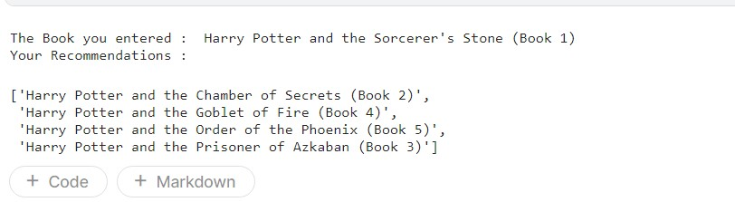
Results and Discussion
ITEM-ITEM COLLABORATIVE FILTERING
Random input
User Input

Slide 13
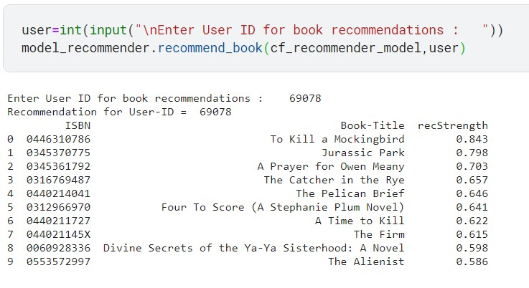
Results and Discussion USER-ITEM COLLABORATIVE FILTERING

Slide 14
Thank You

